Slide 1
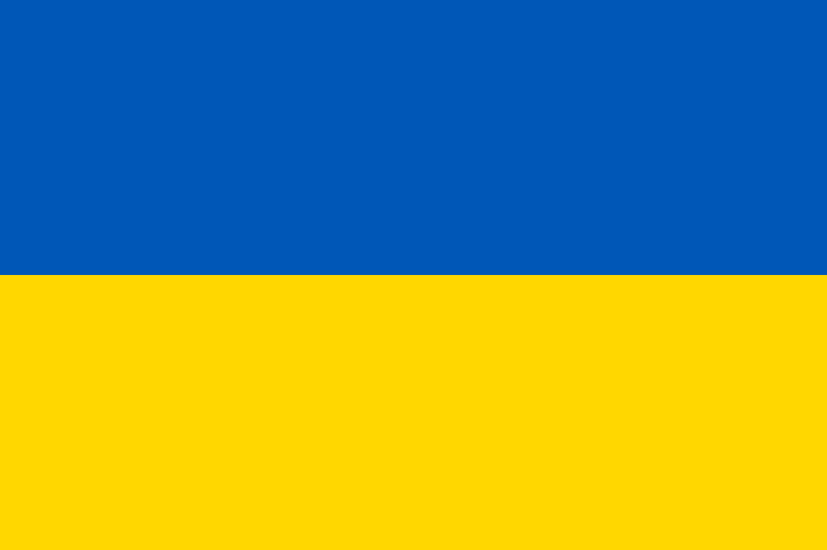
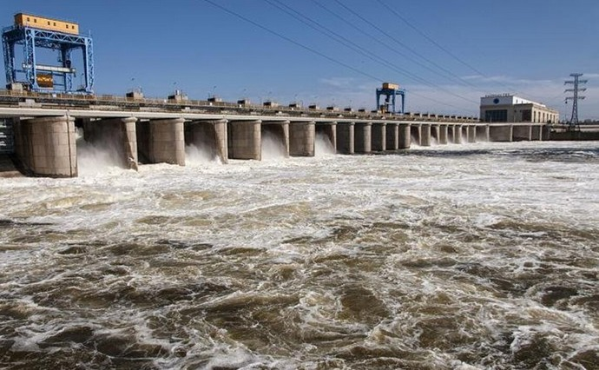
Damage to the Kakhovka hydroelectric power station
KAHOVKA HYDROELECTRIC PLANT.
WATER TERRORISM.
THE BIGGEST MAN-MADE DISASTER IN THE LAST DECADE

Slide 2
Undermining the Kakhovka hydropower station
The undermining of the Kakhovskaya HPP dam, which took place on June 6, 2023, is the largest act of ecocide committed by Russia since the beginning of the full-scale invasion of Ukraine
The total fall of stage is 8.02 m lower than the design level
The destruction of the hydropower station and the dam of the Kakhov reservoir led to uncontrolled release of a huge volume of water, and by 06/13/2023, a total of 14,395 cubic km or 72.5% of the pre-explosion water volume was lost
The volume of water was reduced by 14.775 billion cubic km.

Slide 3
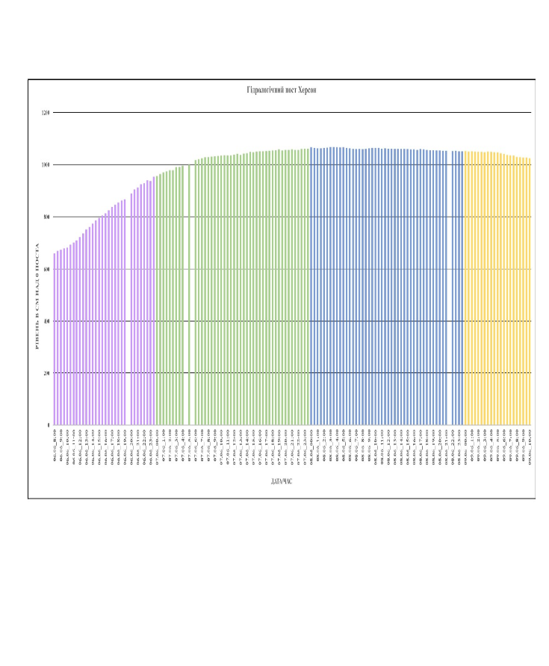
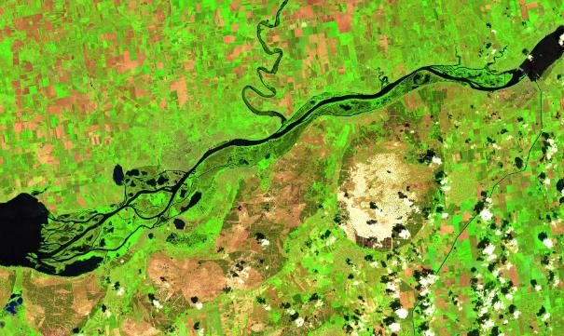
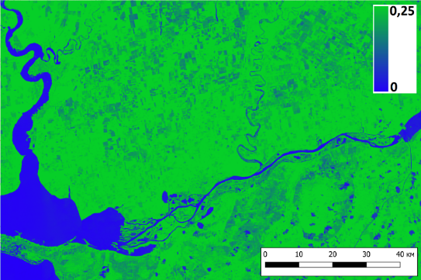
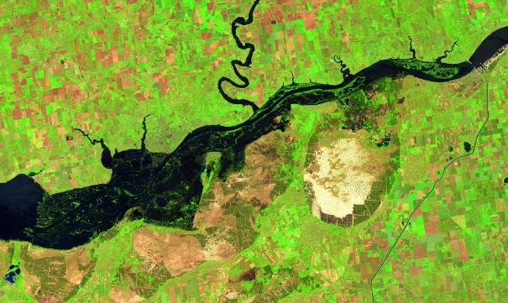
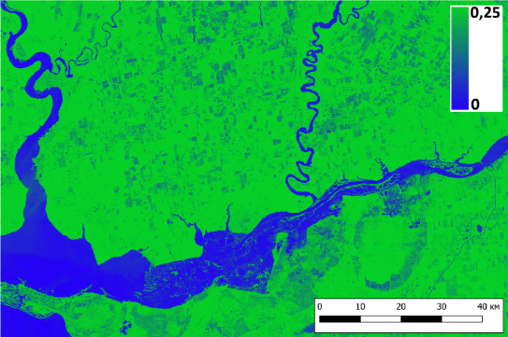
Consequences of flooding
Hydrological post at Kherson
Level in сm over O of the post
Day/time

Slide 4
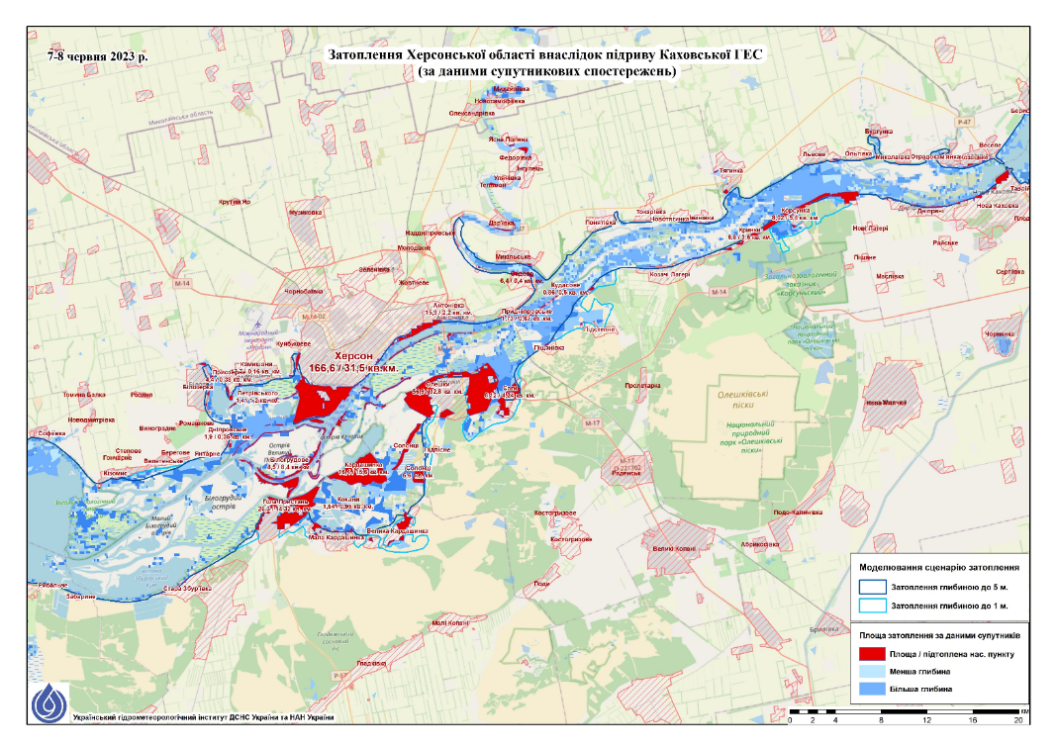
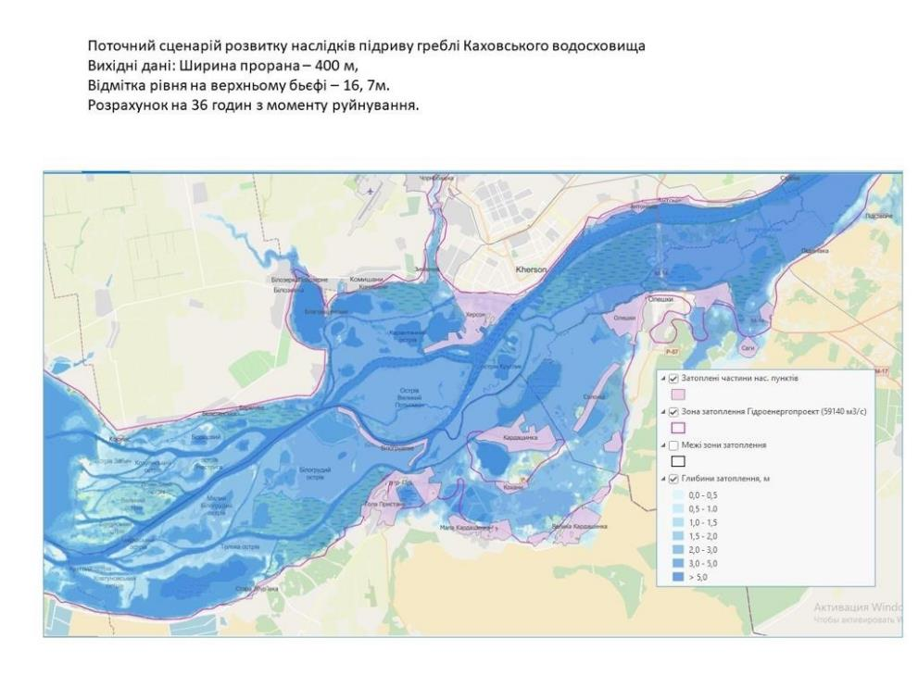
Consequences of flooding
Flooding in Kherson region due to the undermining of Kakhovka HPP
based on satellite data
Current scenario of the development of the consequences of undermining of Kakhovskyi reservoir
Inputs data: width of the passage – 400 m
Level in the upper pool – 16,7 m
Calculations as of 36 hours after the destruction
7-8 June 2023
Flooded municipal areas
Flooded areas
Boundaries of flooded areas
Depth of inundation
flooding with depth by 5
flooding with depth by 1
Flooded municipal areas
Smaller depth
Bigger depth

Slide 5
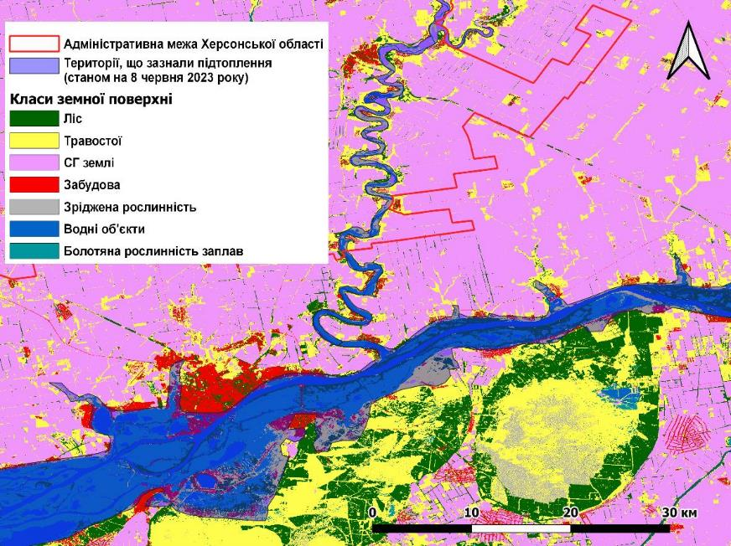
Impact on forest resources
Short-term consequences (up to six months):
Rotting of roots and death of stands due to the lack of oxygen.
Deterioration of the sanitary condition of stands as a result of mass impact caused by diseases and pests.
Degradation of soil quality and reduction of its fertility, as well as the spread of erosion processes.
Losses of biodiversity in forests and adjacent lands.
Long-term consequences (more than a year):
Increasing desertification.
Changes in the hydrological regime and drying up of plantations caused by groundwater level decrease.
Threat to the ecosystem services provided by forests (water conservation, soil protection against water and wind erosion, air purification, oxygen production and carbon absorption).
An increased risk of fires due to lower groundwater level in conifer plantations.

Slide 6
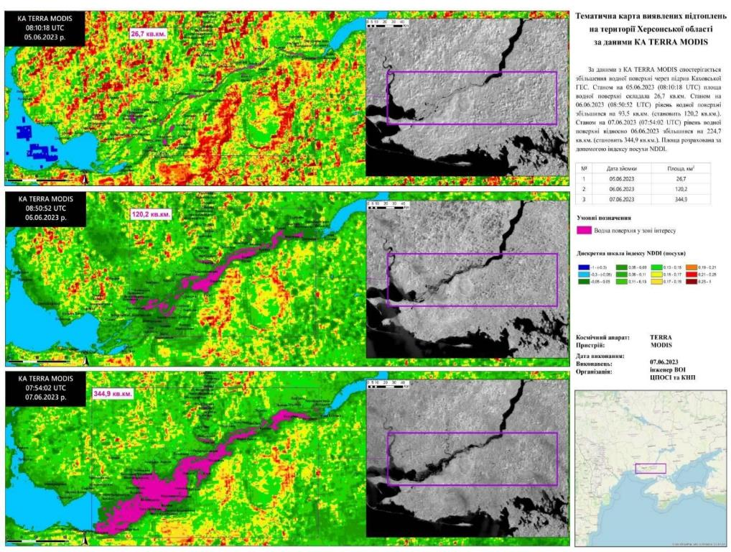
Consequences for the nature reserve fund
The Kakhovka reservoir is one of the sites at the Emerald Network UA0000106 with the area of 218,119 hectares, recognized by the Standing Committee of the Convention on the Protection of Wild Flora and Fauna and Natural Habitats in Europe (the Berne Convention).
Approximate area is ≈ 80177.80 hectares, water elevation is +3.12m. Biodiversity losses: 1140 fauna species (mammals, 57 species of mammals (23 of them are in the Red Book of Ukraine); 8 reptile species and 8 amphibian species.
Affected:
Velikiy Lug and Kamyanska Sich National Reserves.
Nizhnyodniprovsky National Reserve.
National Reserve "Oleshkivski Pisky"

Slide 7
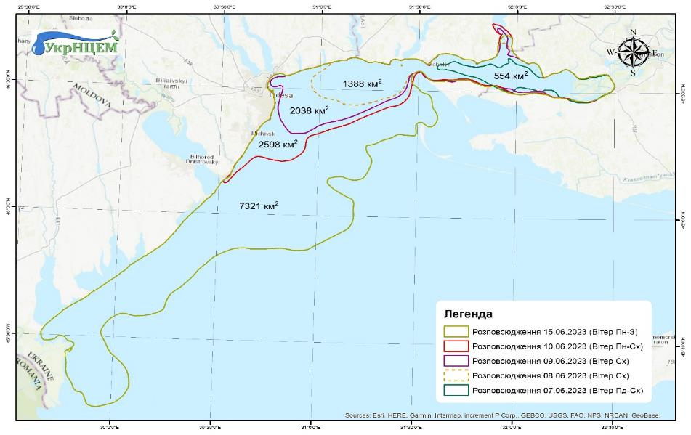
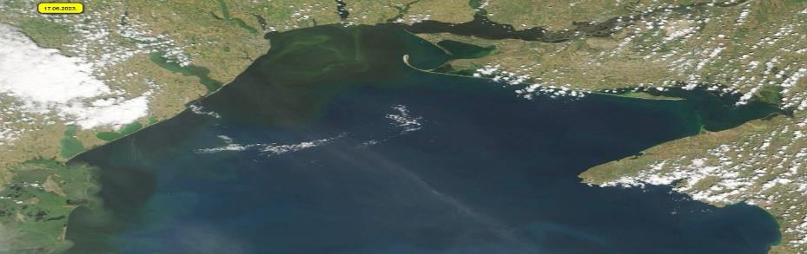
Impact on marine pollution
Water pollution: petroleum products and other hazardous substances that were uptaken by the water will have a negative impact on aquatic biotopes. When an oil film appears on the water surface, it causes death to the benthic and pelagic hydrobionts in the larval stages of development.
Petroleum products and other hazardous substances that penetrated the soil could have a negative impact on the biota.
Impact on the marine environment: oil products and hazardous substances could enter the Black Sea areas that belong to the other countries. An intensive and deep quality control of the water will be required to predict possible impact on the marine environment.
Impact on wildlife: water and soil pollution adversely affects wildlife, including birds, fish and other aquatic animals.
A change in salinity in the Dnipro-Buzka estuary to the level of 0.2 ‰ will lead to changes in the ecosystems of the estuary and the sea.
Distribution of pollution as of

Slide 8
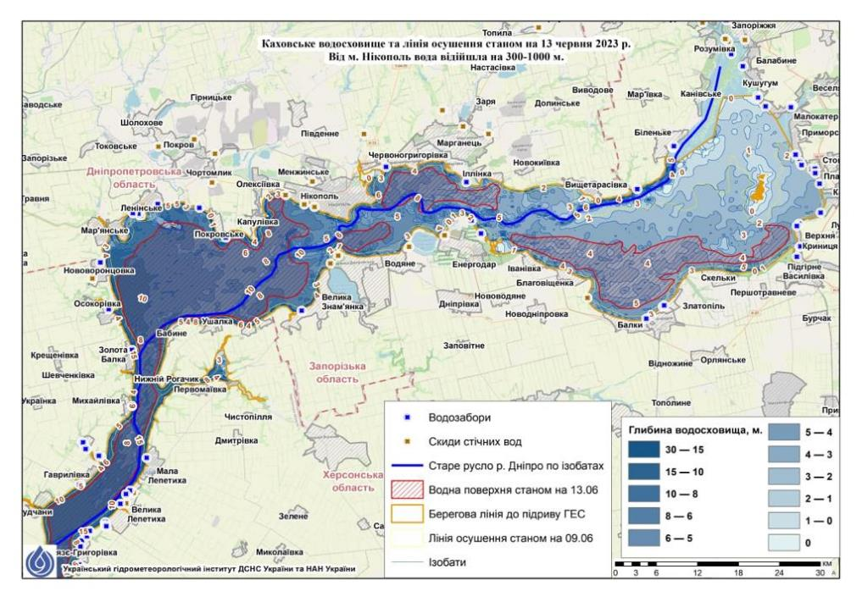
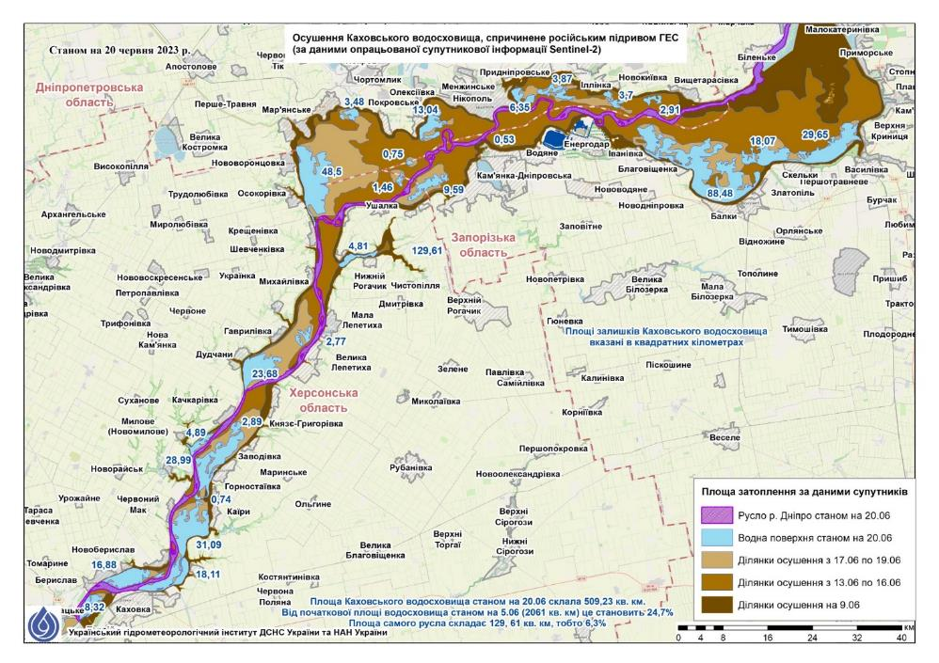
Water losses in the Kakhovka reservoir
Kakhovskyi reservoir and line of draining as of 13 June 2023
Water went away from Nikopol for 300-1000 m
Draining of Kakhovkyi reservoir as of 20.06
Water intakes
Depth of the reservoir
Flooded area according to satellite data
Waste water discharges
Old Dnipro river bed
River bed as of 20.06
Water surface as of 13.06
Water surface as of 20.06
Beach line before undermining of HPP
Drained areas from 17.06 to 19.06
Line of draining as of 09.06
Drained areas from 13.06 to 16.06
Drained areas as of 09.06
Isobates

Slide 9
Water losses in the Kakhovka reservoir
(photos)

Slide 10
Calculation of damages and losses
According to the information of the State Environmental Inspection of Ukraine, approximate calculations of the damage caused by the armed aggression of Russian Federation, namely the detonation of the Kakhovskaya HPP on June 6, 2023, were made. As a result we have the following (amount of damage/losses):
1.26 billion USD – objects of the nature reserve fund;
0.012 billion USD - pollution of the Dnipro River;
0.026 billion USD – pollution by fertilizers, pesticides and agrochemicals;
0.040 billion USD – loss of water resources accumulated in the Kakhovsky Reservoir;
0.168 billion USD – damage to the forest fund;
0.024 billion USD – damage from the probable death of wild animals.
The estimated amount of losses is 1.50 billion USD

Slide 11
Needs for materials to overcome the consequences of the explosion of the Kakhovka hydroelectric power station:
1. The State Water Resources Agency and the State Environmental Inspection need to:
- Mobile laboratories;
- Laboratory equipment (spectrometers, photocolorimeters, conductometers, analyzers, portable refrigerators);
- Test kits for determination of pollutants;
- Reagents for laboratory analysis;
2. National natural parks:
- Off-road equipment (tractors, excavators, armored cars, SUVs);
- Watercraft (boats, boats);
- Means of communication (starlinks, radio stations);
- Power supplies (electric generators, solar batteries);
- Work tools (chainsaws, axes, shovels).
3. Seed material of herbs and plants:
- alfalfa;
- grunt;
- clover;
- oatmeal;
- wheatgrass;
- woodcock;
- warbler;
- and other cereals and legumes
4. List of waste treatment equipment
- Containers for collecting bulky household waste;
- Specialized vehicles;
- Garbage sorting complex
- Container for collecting hazardous waste;
- Mobile incinerator complex.

Slide 12
Questions
Discussion & Questions

